Slide 1

RunVenture Fitness (Run) Tracker
(Based on MapMyRun.com)

Slide 2
What is it?
RunVenture is a fitness tracker app designed to provide runners with a smarter, more personalized training experience.
The app goes beyond basic run tracking by introducing:
Personalized Training Plans, which adapt to users’ goals, fitness levels, and past performance to ensure continuous improvement.
Social Challenges enhance motivation by allowing users to compete with friends and join community challenges.
Music and Podcast Integration brings seamless audio controls into the workout interface, eliminating the need to switch between apps mid-run.
After each session, Post-Run Insights provide actionable feedback, including hydration reminders, stretching guides, and recovery recommendations.
Lastly, Route Conditions give runners a detailed view of their chosen path, displaying surface types, elevation changes, and real-time congestion levels.

Slide 3
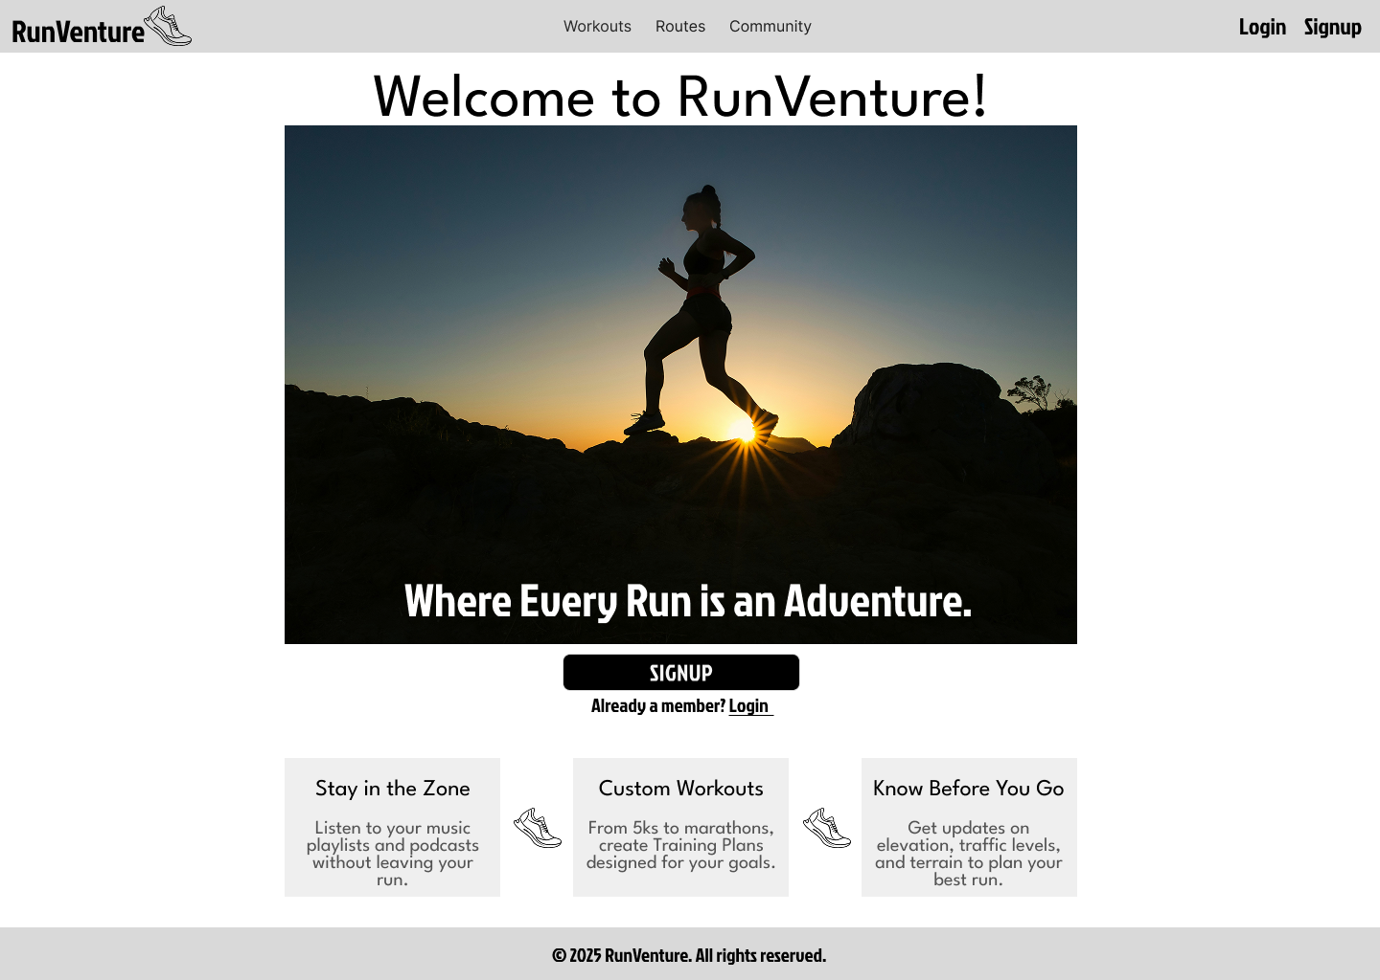
Homepage

Slide 4
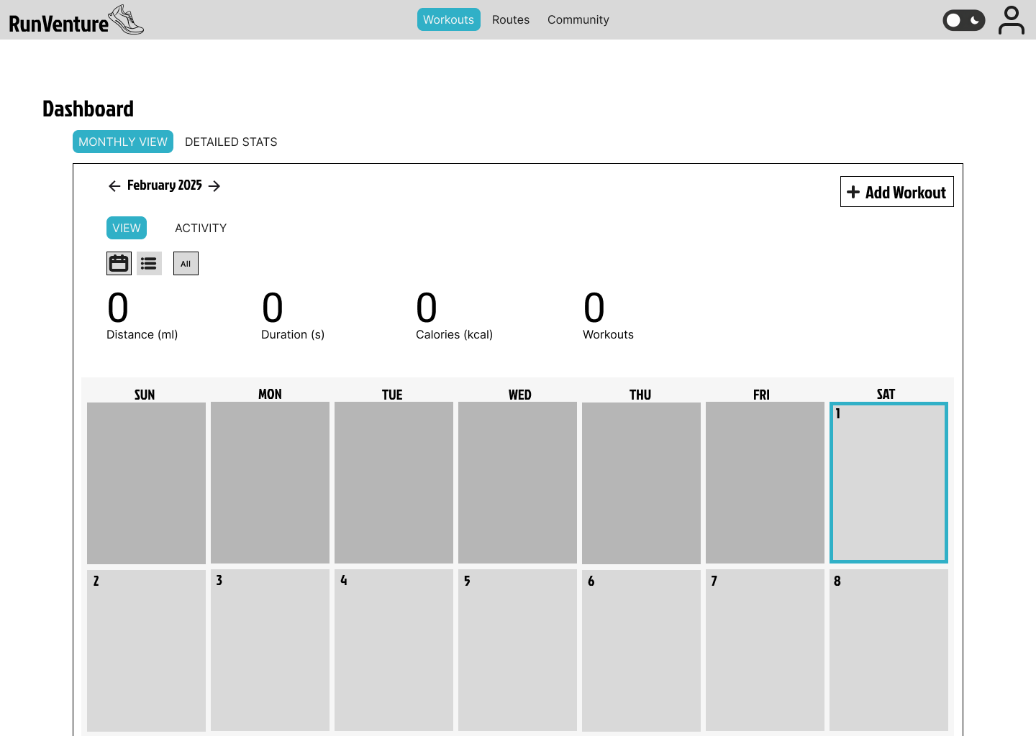
Dashboard (After User Logs In)

Slide 5
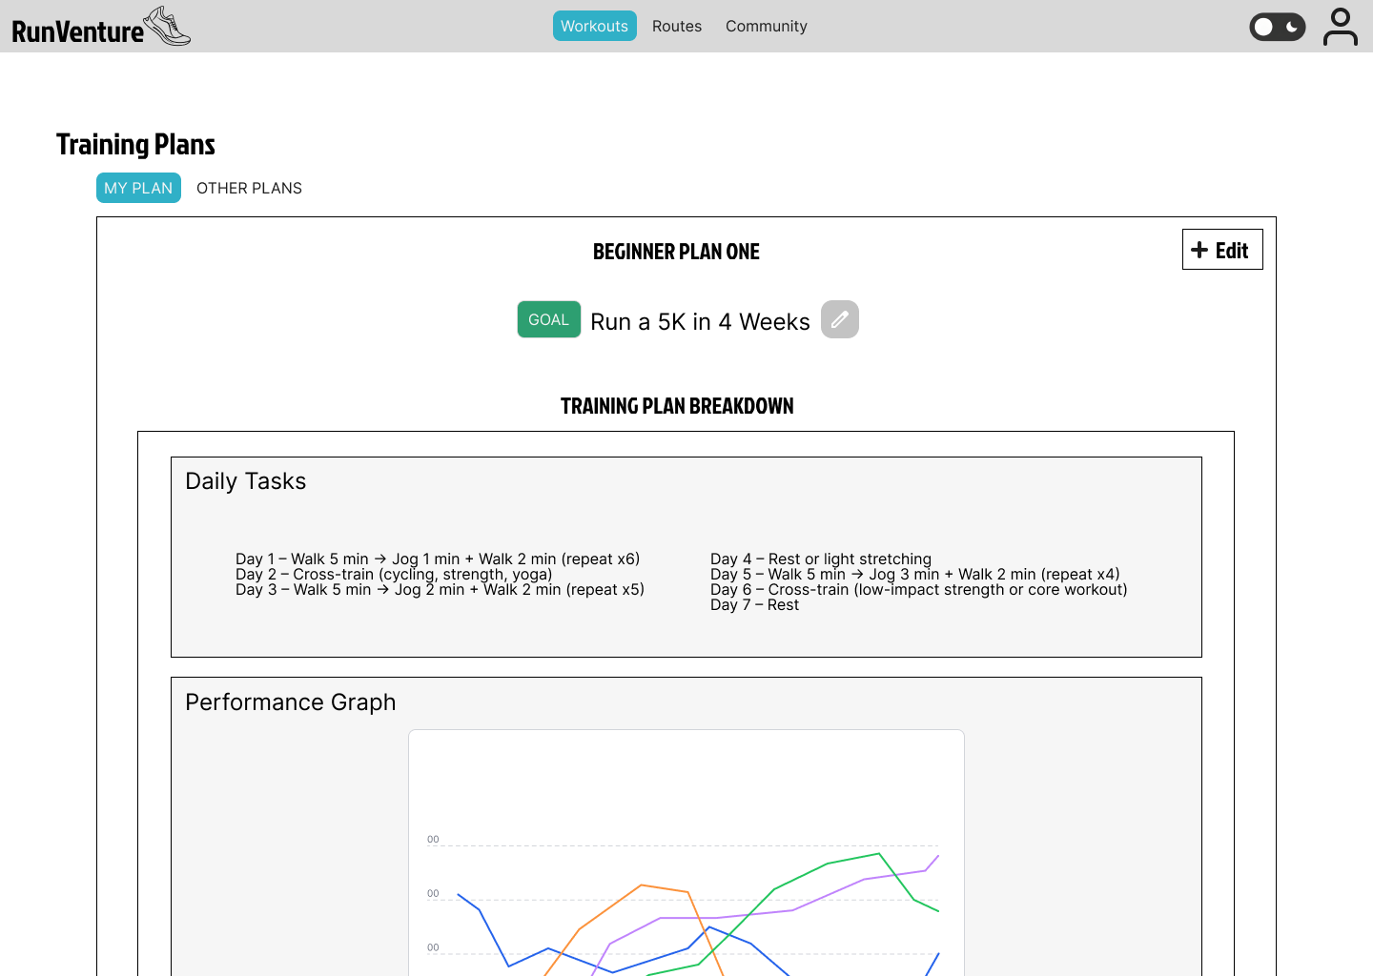
Personalized Training Plans
Overview:
This feature will offer customized training plans tailored to user goals and fitness levels. The goal is to provide users with guidance for their fitness journey and help them achieve specific objectives, whether it's improving endurance, speed, or strength.
Planned Interactions:
Tooltips will guide users through the process of creating and modifying their training plans.
Users can choose from a predefined list of training plans or create personalized ones.
Editable training plans allow users to update goals and performance metrics based on their progress.

Slide 6
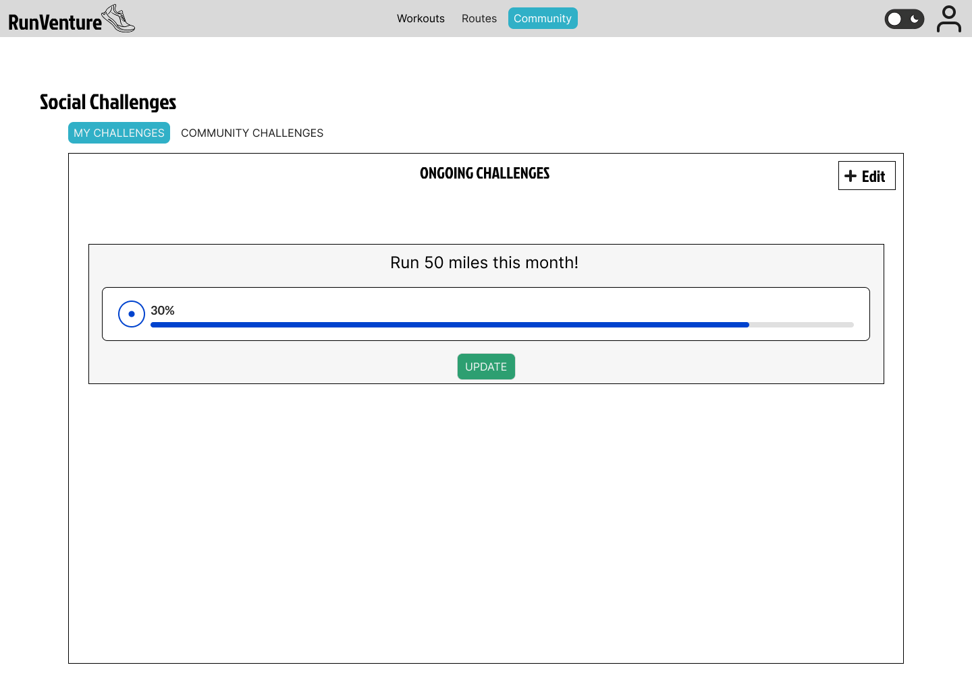
Social Challenges
Overview:
Social Challenges will introduce a competitive and community-driven element to the run tracking app by allowing users to compete with friends, join public challenges, and track progress against others.
Planned Interactions:
Users can update their challenge progress.
Participants' information will be displayed.
Options to share challenge participation or achievements via social media or email.

Slide 7
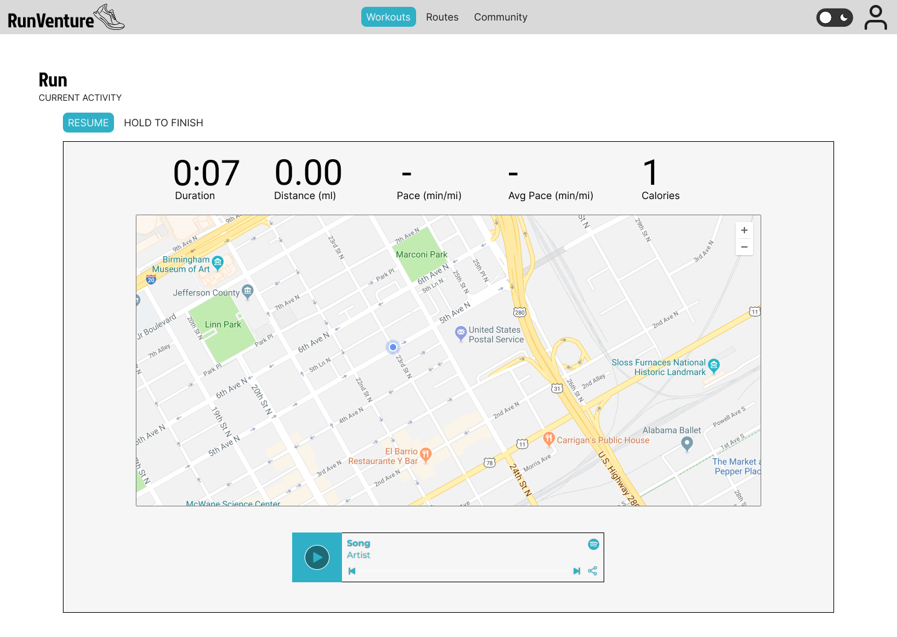
Music and Podcast Integration
Overview:
The app will offer in-app music and podcast playback, enhancing the workout experience. Music controls will be displayed below the live run map for easy access.
Planned Interactions:
Users can play, pause, and skip tracks without leaving the workout interface.
Playlist recommendations based on running intensity.
Podcast playback for users who prefer spoken content during workouts.

Slide 8
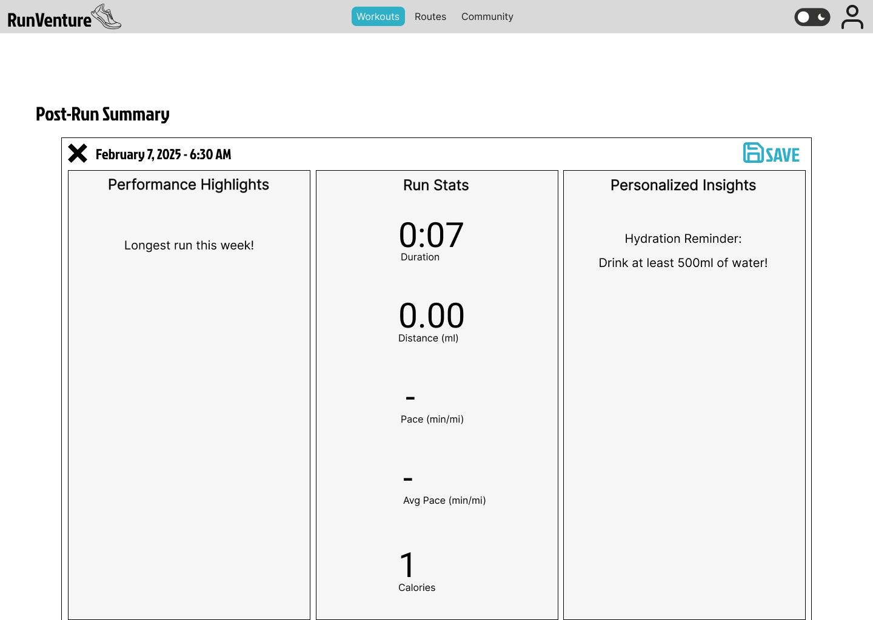
Post-Run Insights
Overview:
After completing a workout, users will receive detailed insights about their performance, recovery needs, and recommendations.
Planned Interactions:
Insights will be auto-generated after each workout.
Users can view performance highlights, run statistics, and advice.
Hydration reminders and recovery suggestions based on run intensity.

Slide 9
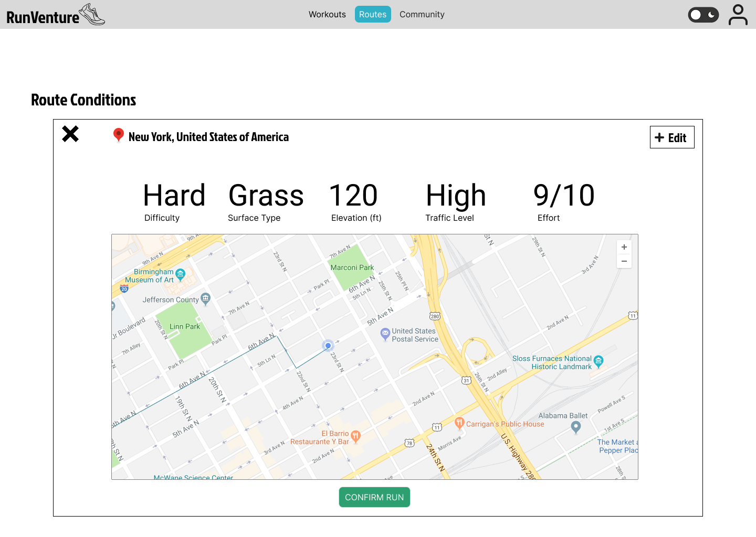
Route Conditions
Overview:
The Route Conditions feature will help users assess the difficulty and suitability of their running routes by providing surface types, elevation changes, and congestion information.
Planned Interactions:
Users can select starting and ending points to generate route insights.
Route details such as surface type (trail, pavement, grass), elevation changes, and congestion levels will be displayed.
Real-time updates for route conditions if available.

Slide 10
Thank you!

